Slide 1
Lecture 17 Neural Networks CS 506 & EC 500
Adam Smith
BU Computer Science

Slide 2
Outline
Softmax and logistic regression
Neurons
Natural
Artificial
Basic structure of feed-forward neural networks for classification
Layered graph, softmax at end
Different activation functions
Gradient descent and regularization
Using Tensorflow
Significance and interpretation

Slide 3
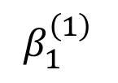
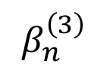

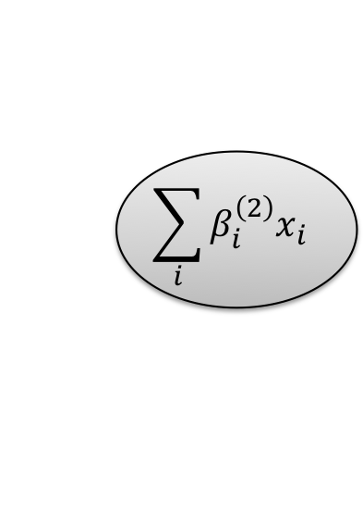

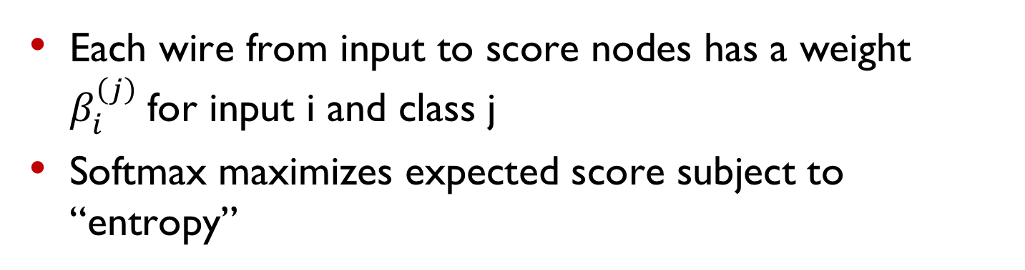
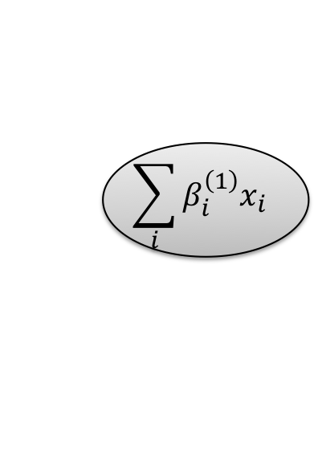
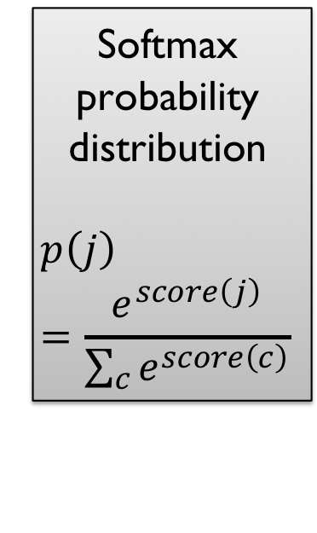
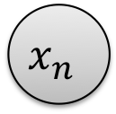
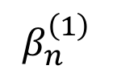

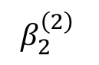
Recall multiclass logistic regression
$$x_{1}$$
$$β_{1}^{\left(1\right)}$$
$$\sum_{i}{β_{i}^{\left(1\right)}x_{i}}$$
Softmax probability distribution
$$p\left(j\right)=\frac{e^{score\left(j\right)}}{\sum_{c}{e^{score\left(c\right)}}}$$
Score for class 1
$$x_{1}$$
$$β_{2}^{\left(2\right)}$$
$$\sum_{i}{β_{i}^{\left(2\right)}x_{i}}$$
Score for class 2
$$β_{n}^{\left(1\right)}$$
$$\sum_{i}{β_{i}^{\left(3\right)}x_{i}}$$
Score for class 3
$$x_{n}$$
$$β_{n}^{\left(3\right)}$$
Each wire from input to score nodes has a weight $β_{i}^{\left(j\right)}$for input i and class j
Softmax maximizes expected score subject to “entropy”

Slide 4
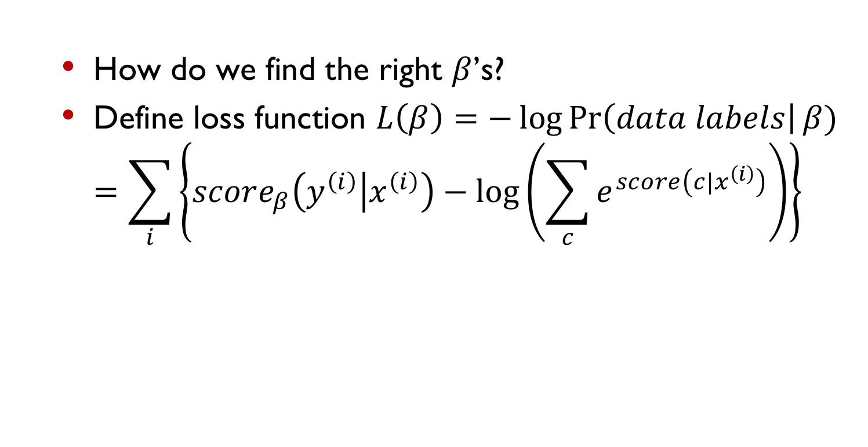
Recall multiclass logistic regression
$$x_{1}$$
$$β_{1}^{\left(1\right)}$$
$$\sum_{i}{β_{i}^{\left(1\right)}x_{i}}$$
Softmax probability distribution
$$p\left(j\right)=\frac{e^{score\left(j\right)}}{\sum_{c}{e^{score\left(c\right)}}}$$
Score for class 1
$$x_{1}$$
$$β_{2}^{\left(2\right)}$$
$$\sum_{i}{β_{i}^{\left(2\right)}x_{i}}$$
Score for class 2
$$β_{n}^{\left(1\right)}$$
$$\sum_{i}{β_{i}^{\left(3\right)}x_{i}}$$
Score for class 3
$$x_{n}$$
$$β_{n}^{\left(3\right)}$$
How do we find the right $β$’s?
Define loss function $L\left(β\right)=−\log{\operatorname{Pr}\left(data labels\right|β)}$ $=\sum_{i}{\left\{score_{β}\left(y^{\left(i\right)} | x^{\left(i\right)}\right)−log\left(\sum_{c}{e^{score\left(c|x^{\left(i\right)}\right)}}\right)\right\}}$

Slide 5
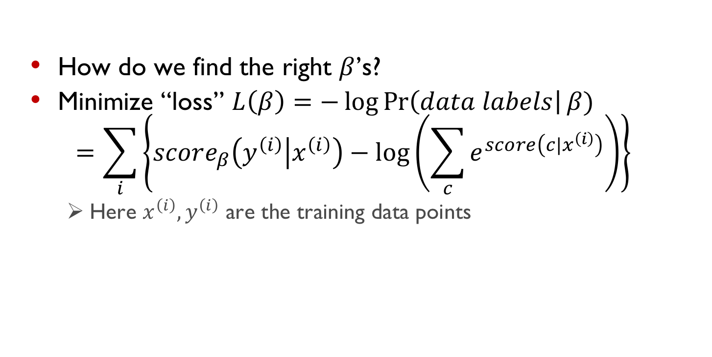
Recall multiclass logistic regression
$$x_{1}$$
$$β_{1}^{\left(1\right)}$$
$$\sum_{i}{β_{i}^{\left(1\right)}x_{i}}$$
Softmax probability distribution
$$p\left(j\right)=\frac{e^{score\left(j\right)}}{\sum_{c}{e^{score\left(c\right)}}}$$
Score for class 1
$$x_{1}$$
$$β_{2}^{\left(2\right)}$$
$$\sum_{i}{β_{i}^{\left(2\right)}x_{i}}$$
Score for class 2
$$β_{n}^{\left(1\right)}$$
$$\sum_{i}{β_{i}^{\left(3\right)}x_{i}}$$
Score for class 3
$$x_{n}$$
$$β_{n}^{\left(3\right)}$$
How do we find the right $β$’s?
Minimize “loss” $L\left(β\right)=−\log{\operatorname{Pr}\left(data labels\right|β)}$ $=\sum_{i}{\left\{score_{β}\left(y^{\left(i\right)} | x^{\left(i\right)}\right)−log\left(\sum_{c}{e^{score\left(c|x^{\left(i\right)}\right)}}\right)\right\}}$
Here $x^{\left(i\right)}, y^{\left(i\right)}$ are the training data points

Slide 6

How can we generalize this?
We will create an architecture with many layers
Each layer moves information to the next
Like a feed-forward digital circuit, except…
Real values on the wires
Basic gate is a “neuron”
(function of weighted sum of input values)
Inspiration: brains run effective algorithms!
Powered by plant matter
Low energy use
Excellent visual/olfactory /audio processing
(Your mileage may vary)

Slide 7

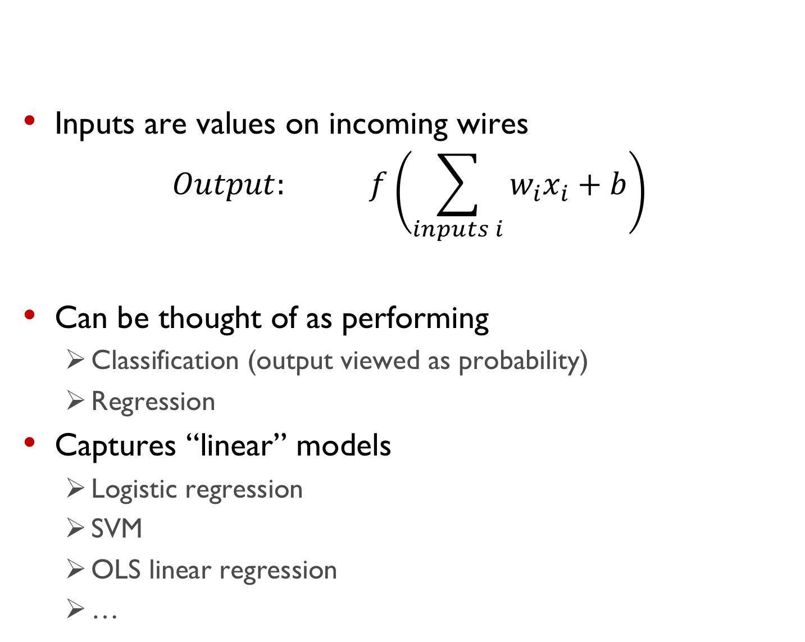
An abstract neuron
Inputs are values on incoming wires
$$Output: f\left(\sum_{inputs i}{w_{i}x_{i}+b}\right)$$
Can be thought of as performing
Classification (output viewed as probability)
Regression
Captures “linear” models
Logistic regression
SVM
OLS linear regression
…
Activation function
bias
weight
Input

Slide 8
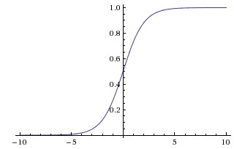
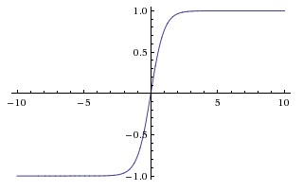
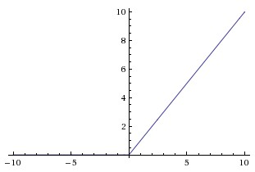
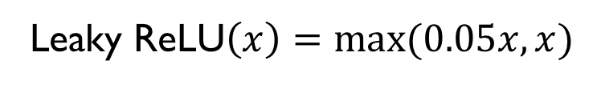
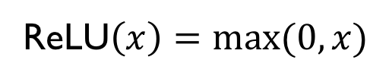
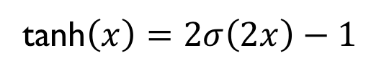
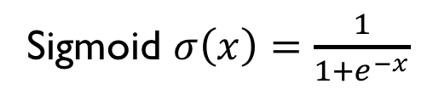
Common activation functions
Sigmoid $σ\left(x\right)=\frac{1}{1+e^{−x}}$
tanh$\left(x\right)=2σ\left(2x\right)−1$
ReLU$\left(x\right)=max⁡(0,x)$
Leaky ReLU$\left(x\right)=max⁡(0.05x,x)$

Slide 9
Common activation functions
Different activation functions…
Some are easier to “train” than others
Capture different types of information
Sigmoid $σ\left(x\right)=\frac{1}{1+e^{−x}}$
tanh$\left(x\right)=2σ\left(2x\right)−1$
ReLU$\left(x\right)=max⁡(0,x)$
Leaky ReLU$\left(x\right)=max⁡(0.05x,x)$

Slide 10


Layered architecture
Input layer: raw “features” (maybe carefully selected)
Output layer: no “activation” (output linear combination)
Hidden neurons: nonlinear activation function
Not pictured here: final decision (e.g. softmax classifier)

Slide 11
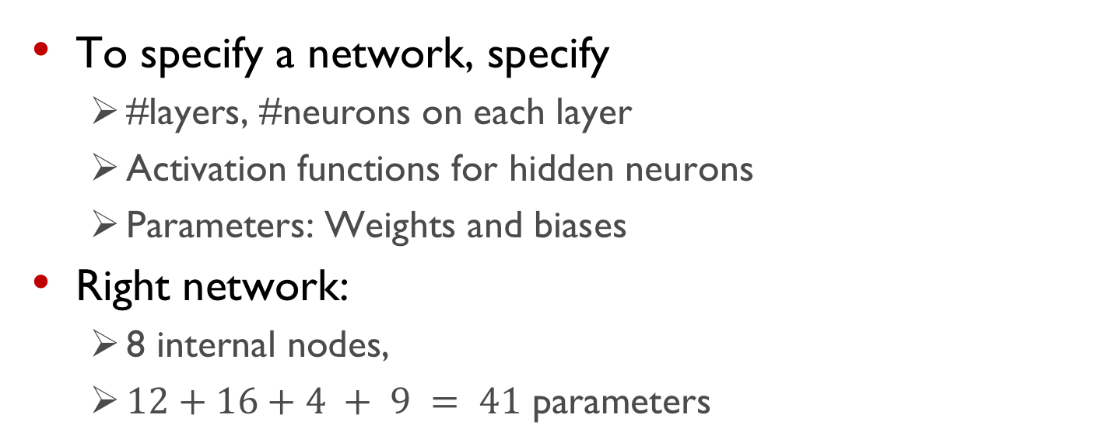
Layered architecture
To specify a network, specify
#layers, #neurons on each layer
Activation functions for hidden neurons
Parameters: Weights and biases
Right network:
8 internal nodes,
$12+16+4 + 9 = 41$ parameters
How many parameters on the left?
4
6
20
26
32
None of the above

Slide 12
Layered architecture
Why are internal neurons’ activation functions nonlinear?
To mimic structure in human brains
Because it works in practice
If they were linear, we could eliminate the hidden layers
It’s deep, man.
All of the above
None of the above

Slide 13
Layered architecture
We can view everything but the last layer as computing features for a linear classifier/regression model
However, we will “learn” this representation from the data, rather than specifying it manually
Let’s try it!

Slide 14
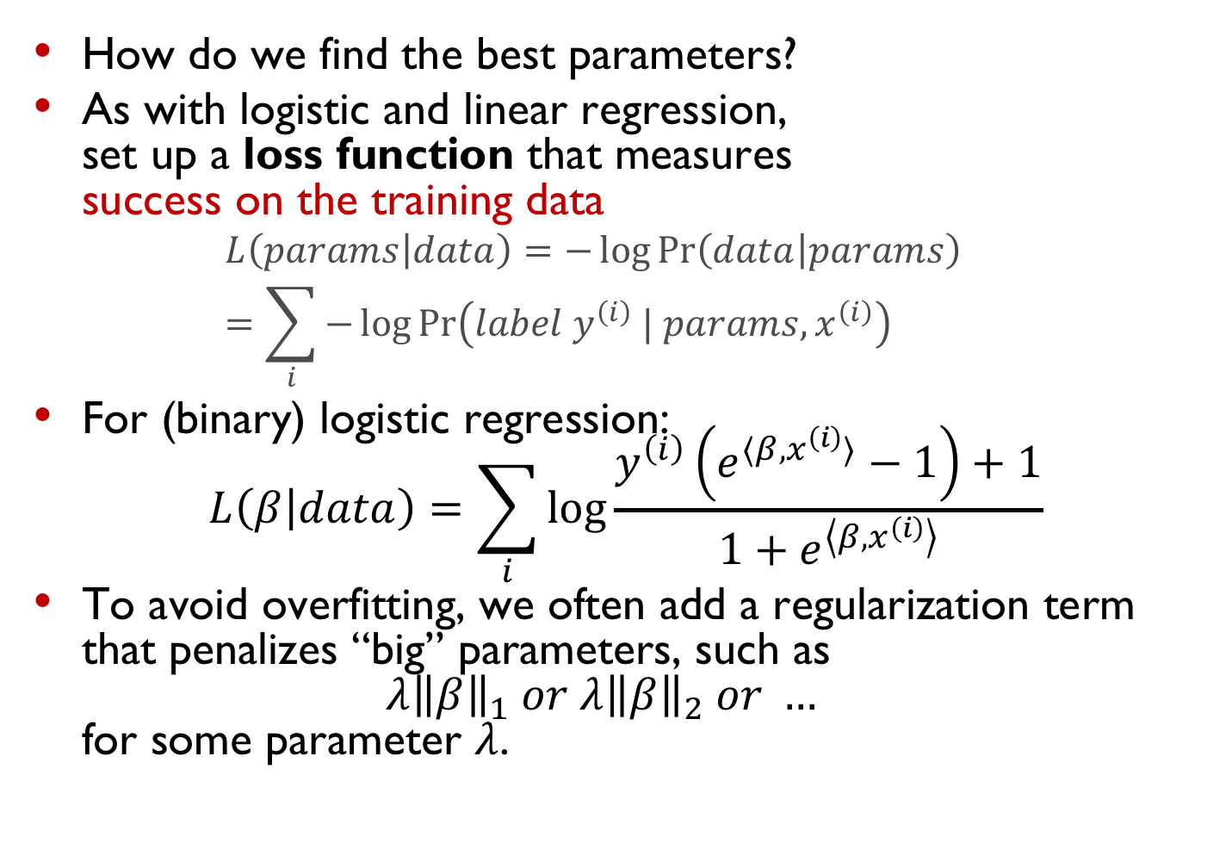
Training and regularization
How do we find the best parameters?
As with logistic and linear regression, set up a loss function that measures success on the training data
$$L\left(params | data\right)=−\log{\operatorname{Pr}\left(data | params\right)} \\ =\sum_{i}{−\log{\operatorname{Pr}\left(label y^{\left(i\right)} | params, x^{\left(i\right)}\right)}}$$
For (binary) logistic regression: $L\left(β | data\right)=\sum_{i}{\log{\frac{y^{\left(i\right)}\left(e^{⟨β,x^{\left(i\right)}⟩}−1\right)+1}{1+e^{\left\langle β,x^{\left(i\right)}\right\rangle }}}}$
To avoid overfitting, we often add a regularization term that penalizes “big” parameters, such as ${λ\left\|β\right\|}_{1} or {λ\left\|β\right\|}_{2} or …$ for some parameter $λ$.

Slide 15
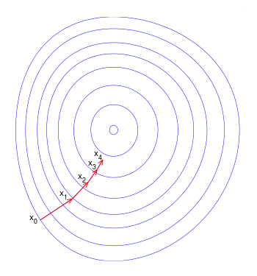
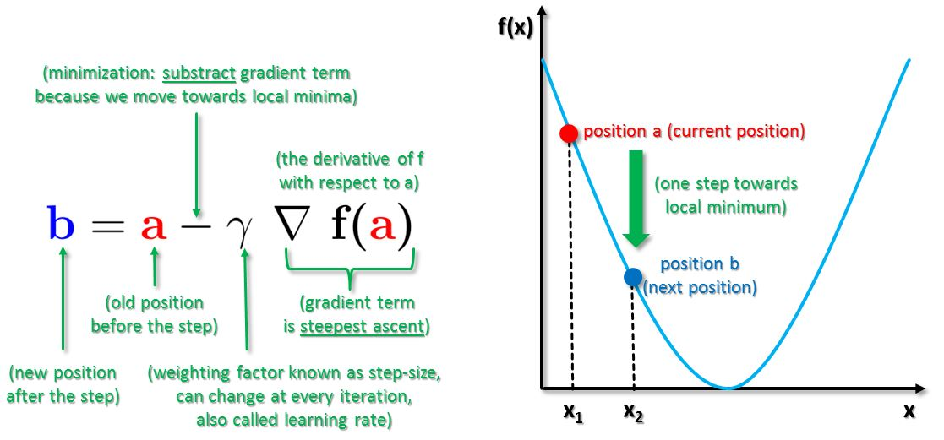
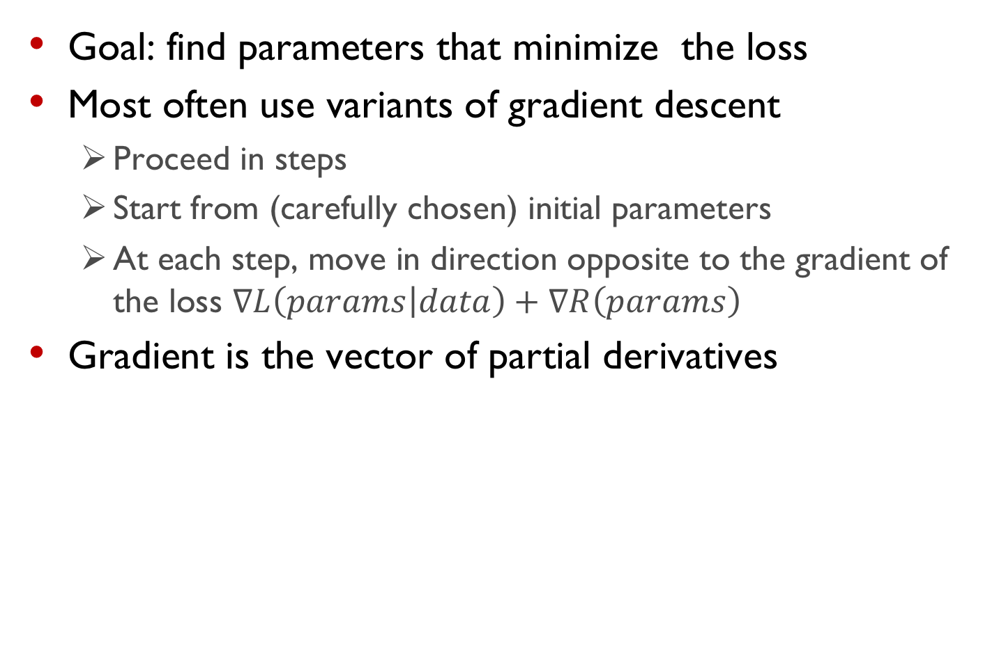
Fitting the model = minimizing loss
Goal: find parameters that minimize the loss
Most often use variants of gradient descent
Proceed in steps
Start from (carefully chosen) initial parameters
At each step, move in direction opposite to the gradient of the loss $∇L\left(params | data\right)+∇R\left(params\right)$
Gradient is the vector of partial derivatives

Slide 16
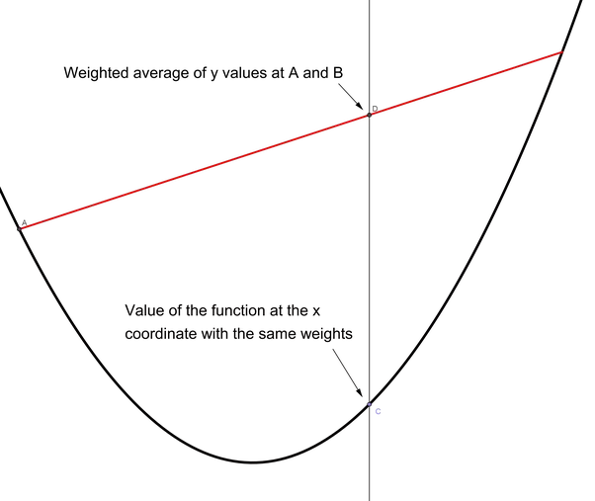
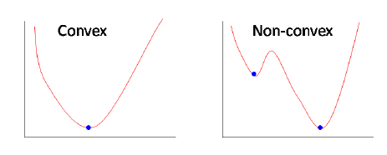
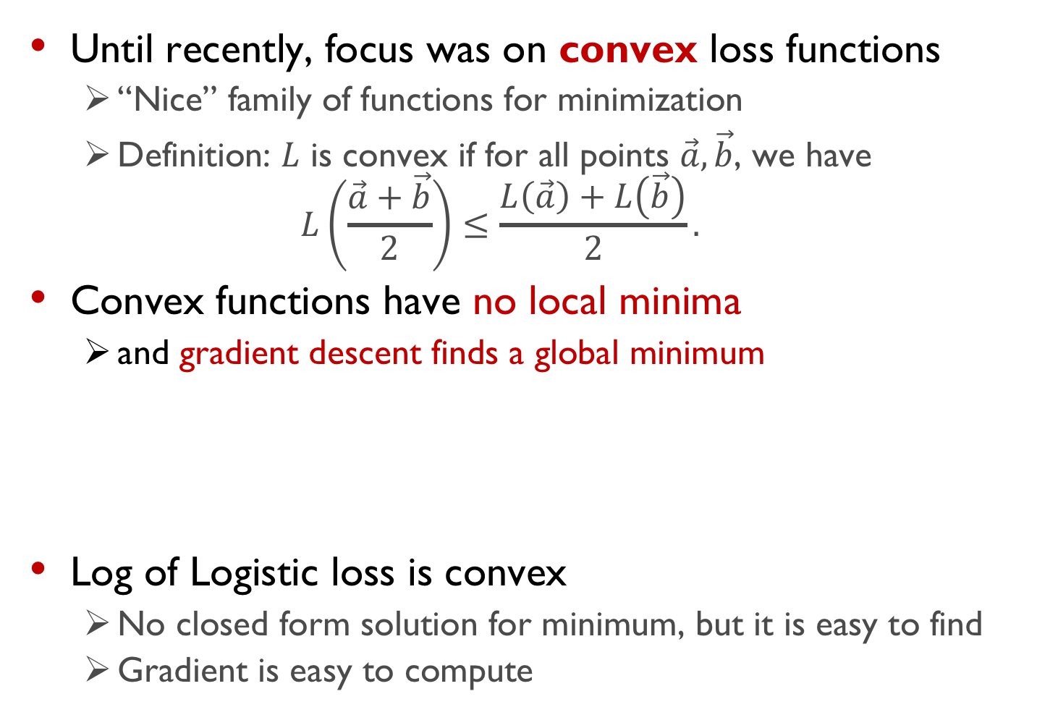
Fitting the model = minimizing loss
Until recently, focus was on convex loss functions
“Nice” family of functions for minimization
Definition: $L$ is convex if for all points $\vec{a}, \vec{b}$, we have $L\left(\frac{\vec{a}+\vec{b}}{2}\right)≤\frac{L\left(\vec{a}\right)+L\left(\vec{b}\right)}{2}.$
Convex functions have no local minima
and gradient descent finds a global minimum
Log of Logistic loss is convex
No closed form solution for minimum, but it is easy to find
Gradient is easy to compute

Slide 17
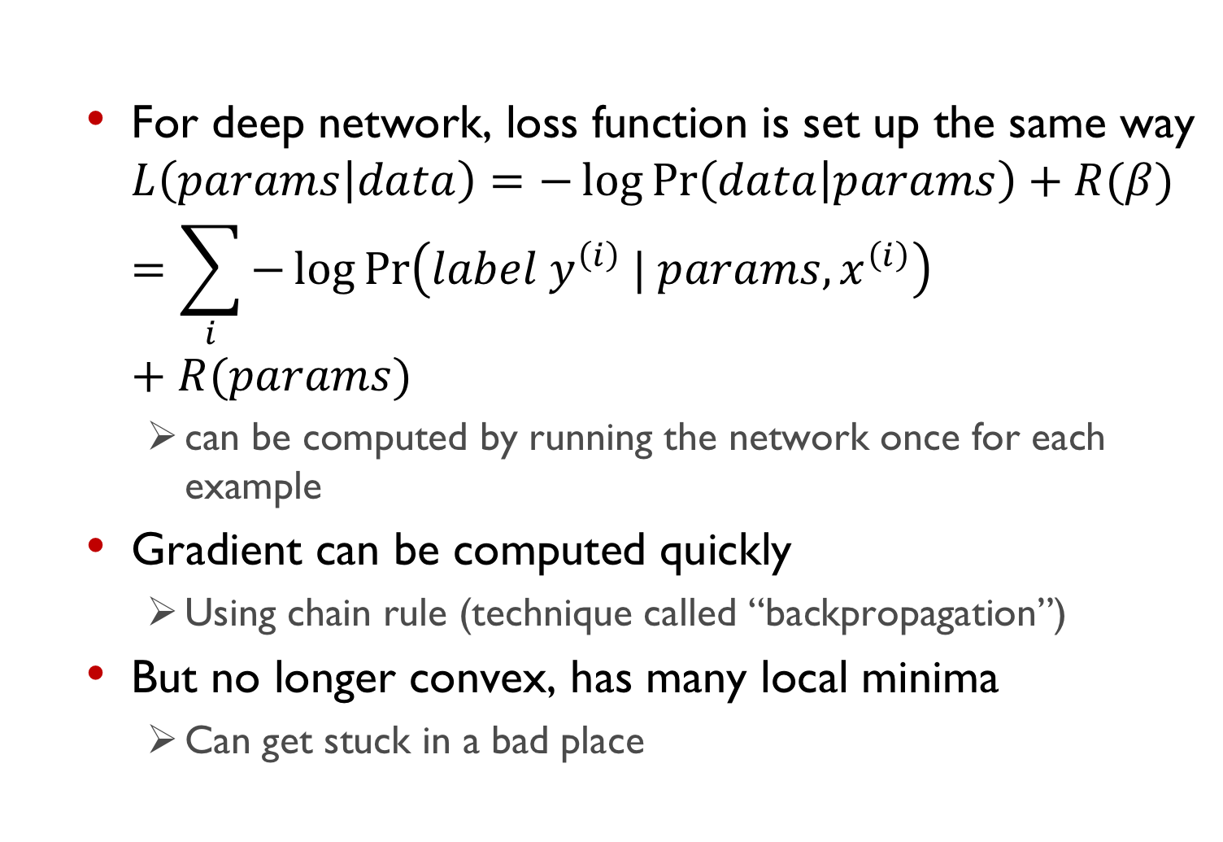
Training and regularization
For deep network, loss function is set up the same way $L\left(params | data\right)=−\log{\operatorname{Pr}\left(data | params\right)}+R(β)$ $=\sum_{i}{−\log{\operatorname{Pr}\left(label y^{\left(i\right)} | params, x^{\left(i\right)}\right)}}+R(params)$
can be computed by running the network once for each example
Gradient can be computed quickly
Using chain rule (technique called “backpropagation”)
But no longer convex, has many local minima
Can get stuck in a bad place

Slide 18
Why do we not use linear thresholds?
We care about multiclass problems with many possible outputs
Gradients too hard to compute?
Many local minima of corresponding loss function
Gradients are not informative
None of the above
Answer: (d). With these activation functions, the gradients will always be 0, so gradient-based algorithms will not work.

Slide 19
Deep learning in Python
Popular frameworks
Tensorflow
PyTorch
…many others
Will make hard decisions for you (regularization, gradient descent step size, etc)
Also allow for fine-grained control
Much of the power of deep networks from complex use in vision and natural language applications
Many other courses at BU!
Today: an example of DNN classification in TensorFlow

Slide 20
Some things to remember
Bigger networks are more expressive but require more data to train
Regularization makes a huge difference
Deep nets overfit easily
You still need to evaluate accuracy using a test set.
Deep nets are mostly good at prediction
There is no broadly applicable notion of “statistical validity” for particular links in a deep net
Too many confounding factors to allow for easy interpretation
Also a problem for high-stakes applications

Slide 21
Further reading
Stanford CS231n lecture notes http://cs231n.github.io/neural-networks-1/
Deep learning tutorial http://www.deeplearning.net/tutorial/mlp.html
TensorFlow visual demo https://playground.tensorflow.org
Tensorflow and PyTorch tutorials

